Slide 1
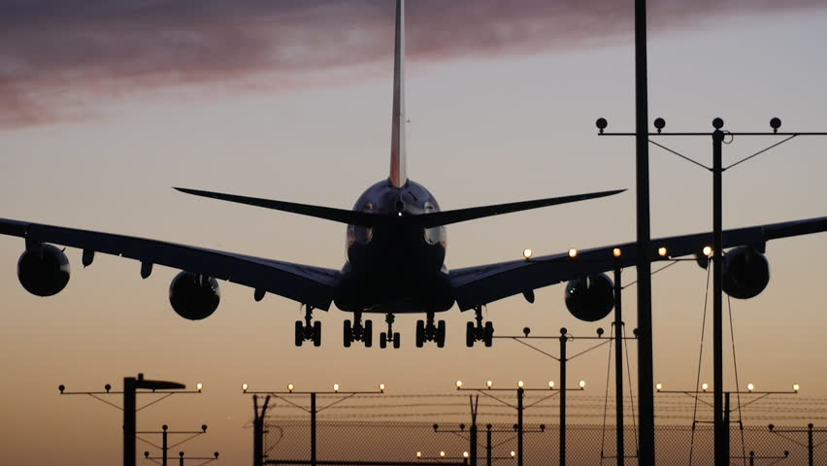
AIRLINE MANAGEMENT SYSTEM
Supervised BY:
Abida Sanjana
Ahmed Nafis Fuad
(1505113)
Md Awsaf Alam
(1505114)

Slide 2
Modules
1. Ticket Booking System
-For Passengers
2. Schedule Management
-For Flight crew and other employees
3. Sales Report & Aircraft maintenance
-For Manager

Slide 3
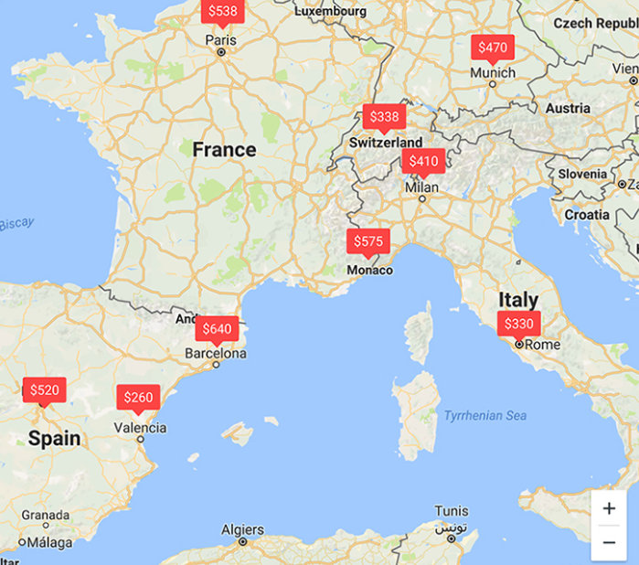
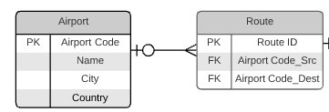
Sample GUI

Slide 4
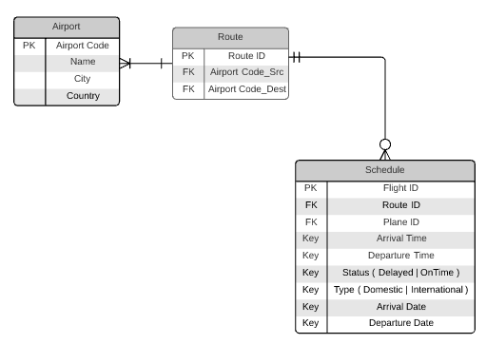
Taken By

Slide 5
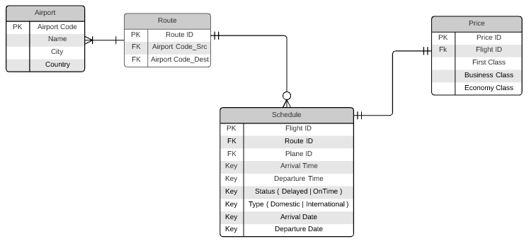

Slide 6
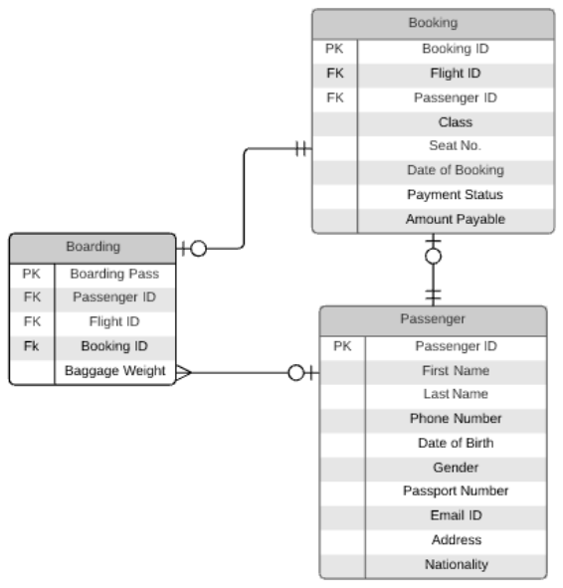

Slide 7
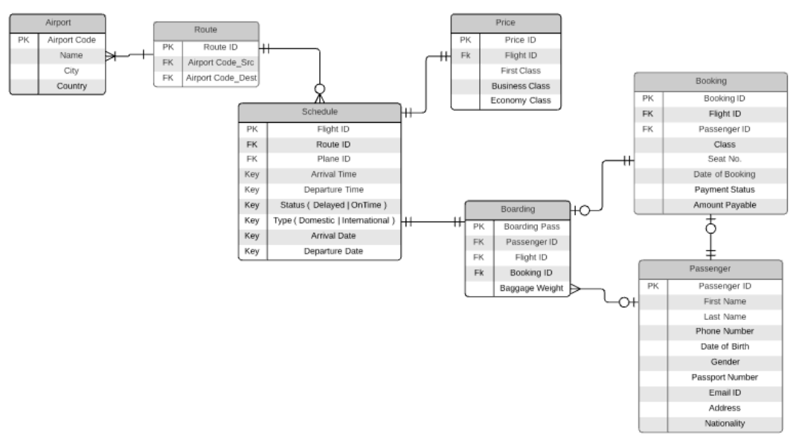

Slide 8
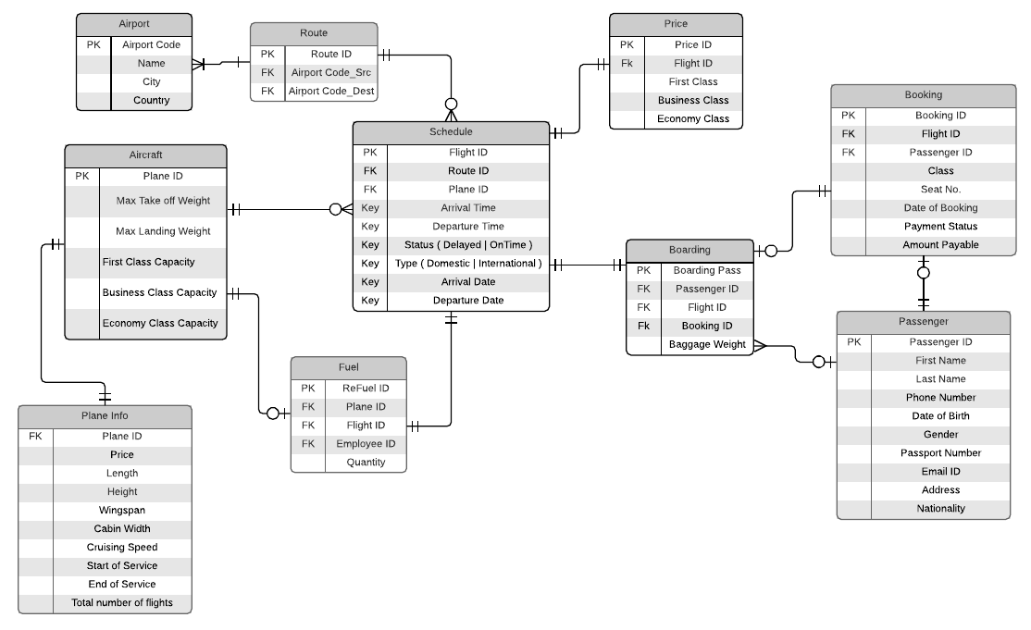

Slide 9
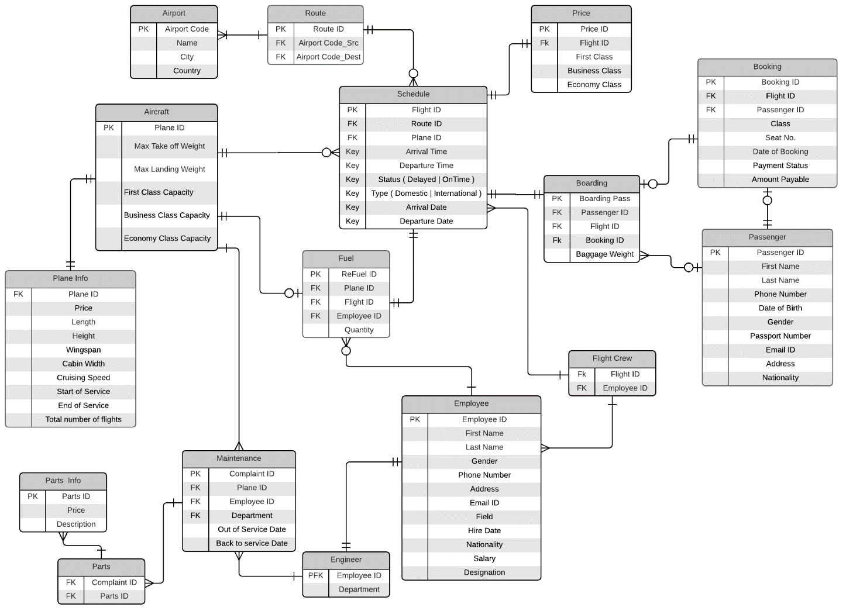

Slide 10
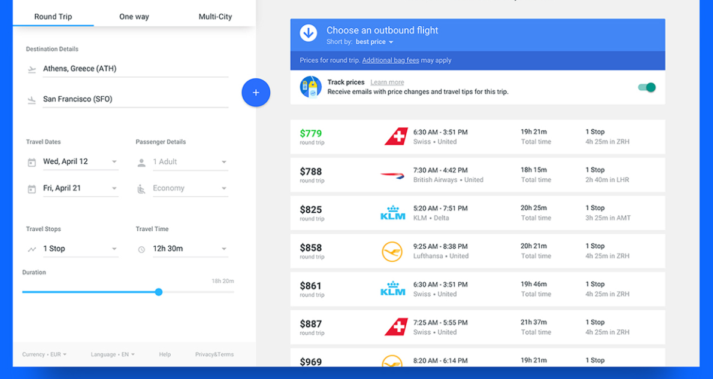
Ticket Booking

Slide 11
Sample Queries
Show all schedules from Dhaka to Kolkata
Find the seat number of John in Flight number 1317
Display all the passengers on Flight number 1897 and their seats

Slide 12
Any Questions?

